Slide 1
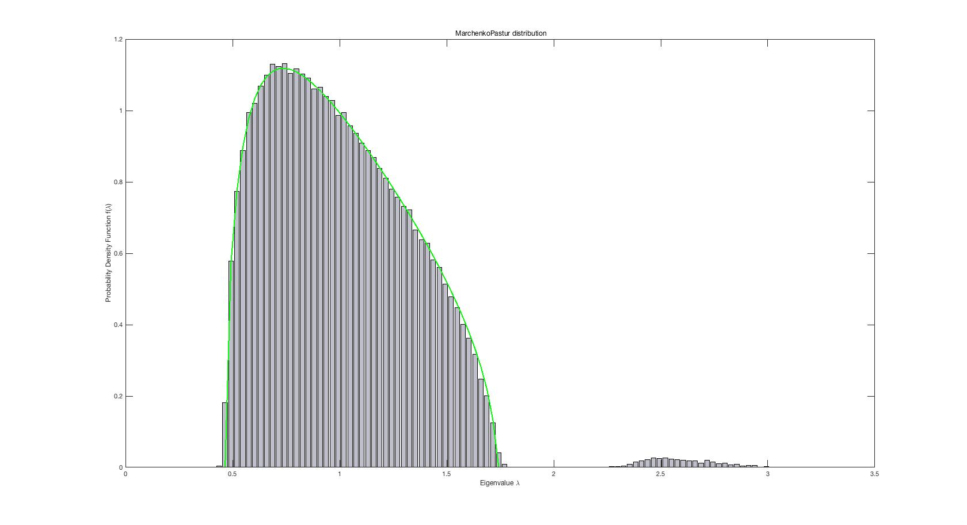
-25dB

Slide 2
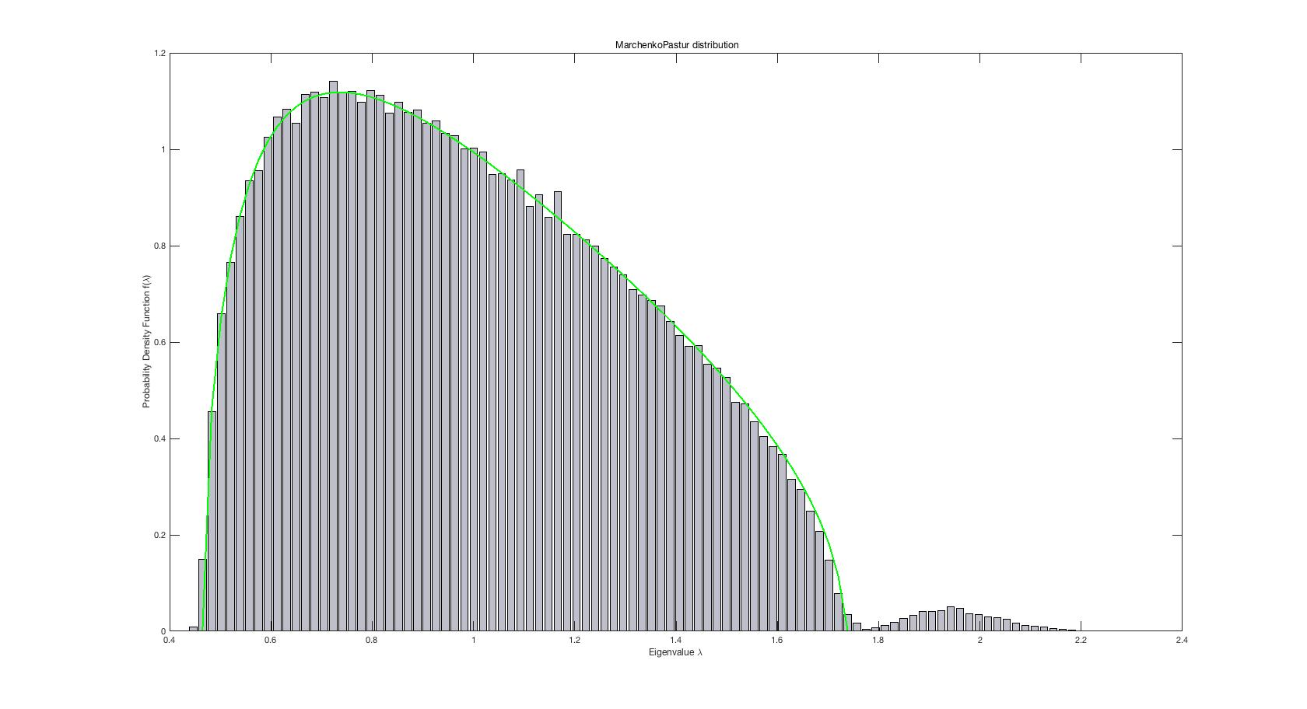
-28dB

Slide 3
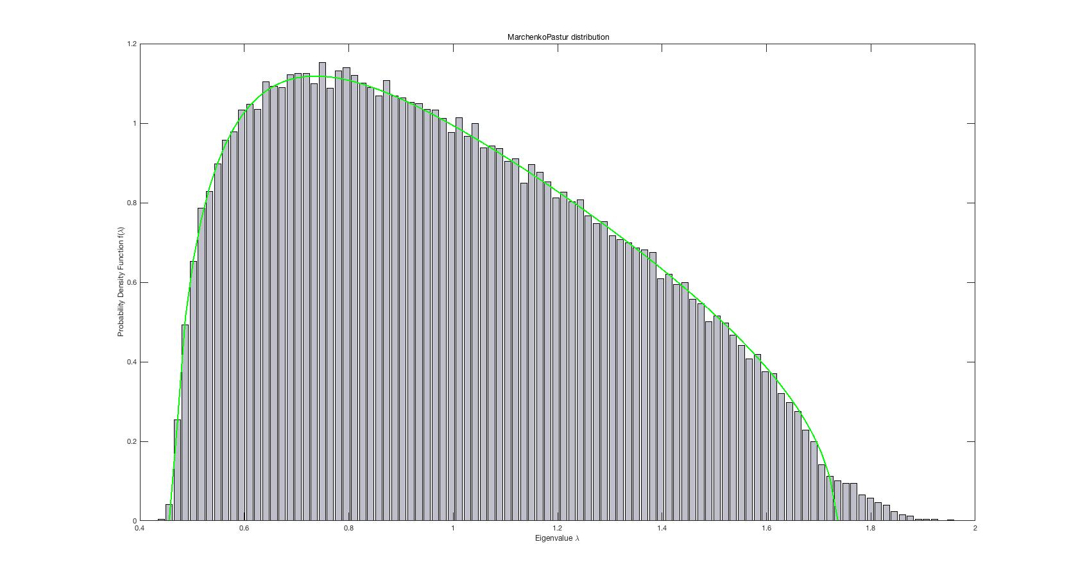
-30dB

Slide 4
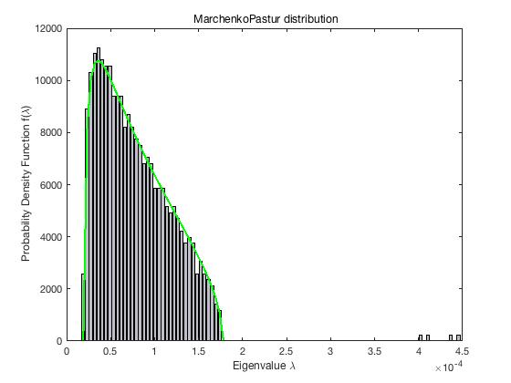
Only one Signal ，one jamming ，one BS

Slide 5
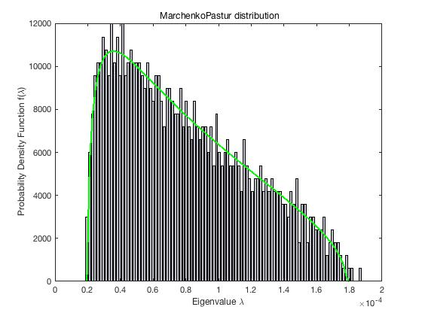

Slide 6
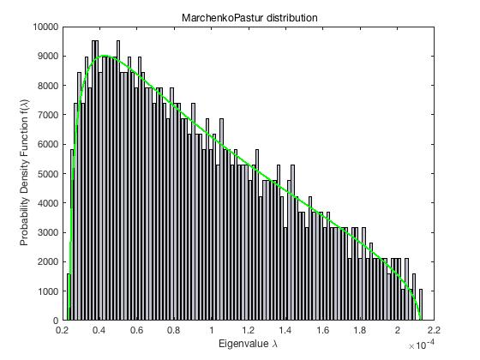

Slide 7
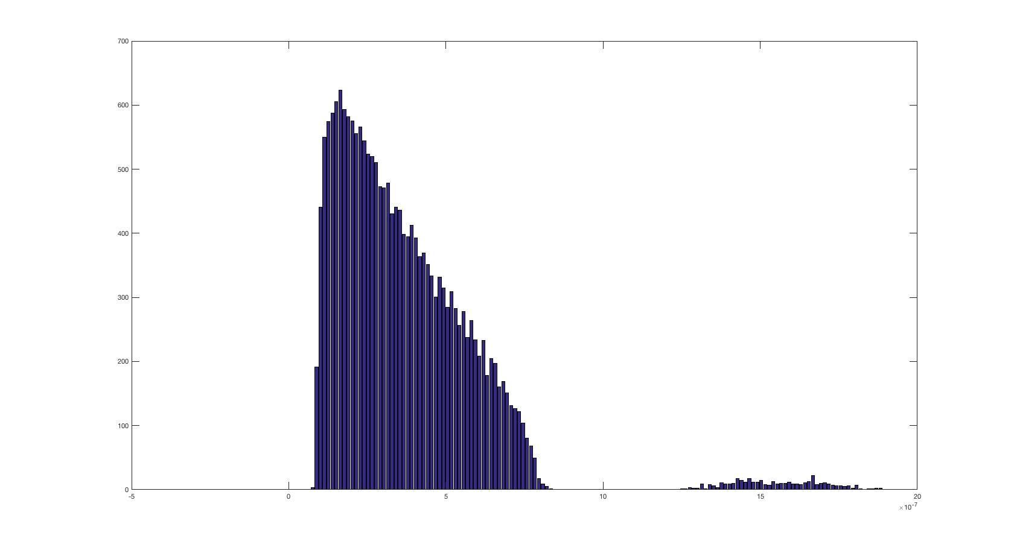
Signal Amplitude=0.5 Gain=0 BS=12
Jamming Amplitude=1 Gain=15 Jamming=4

Slide 8
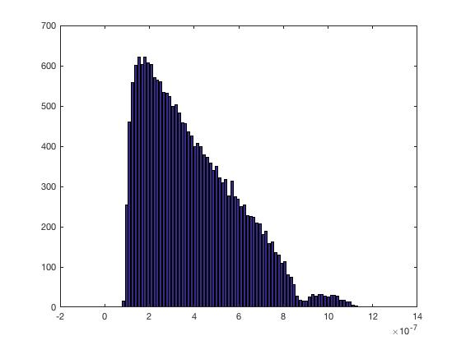
Signal Amplitude=0.2 Gain=0 BS=12
Jamming Amplitude=1 Gain=17 Jamming=4

Slide 9
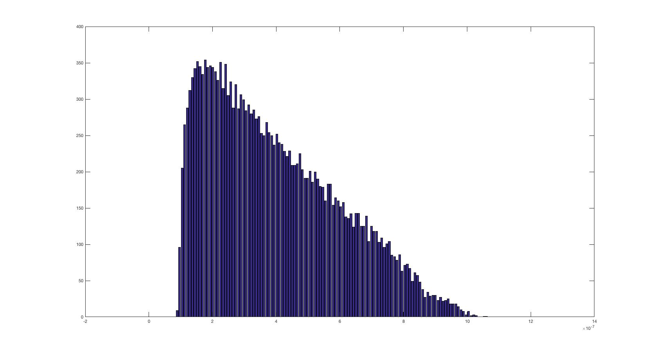
Signal Amplitude=0.2 Gain=0 BS=12
Jamming Amplitude=1 Gain=20 Jamming=4

